Slide 1
Chapter 1 1.4 Units of Measurement
Chemistry, The Central Science, 10th edition
Theodore L. Brown; H. Eugene LeMay, Jr.; and Bruce E. Bursten

Slide 2
Learning Goals:
By the end of class you will be able to…
Identify SI units.
Identify the uncertainty in measurements.
Convert units using dimensional analysis.

Slide 3
Recall: Physical Properties
Physical Properties can also be further classified as either Qualitative (can be described) Ex: colour, texture, taste, smell
or Quantitative (can be measured numerically) Ex: melting/boiling points, density, viscosity.

Slide 4
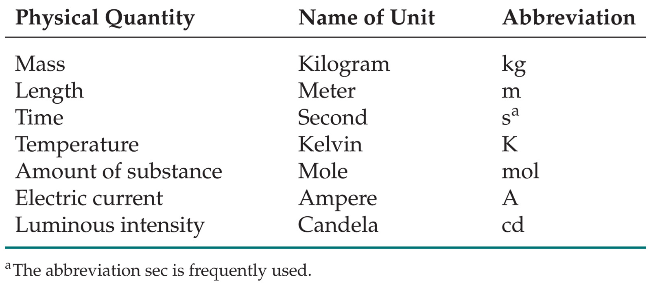
SI Units Learn! symbols and all!
SI stands for Système International d’Unités
Uses a different base unit for each quantity

Slide 5
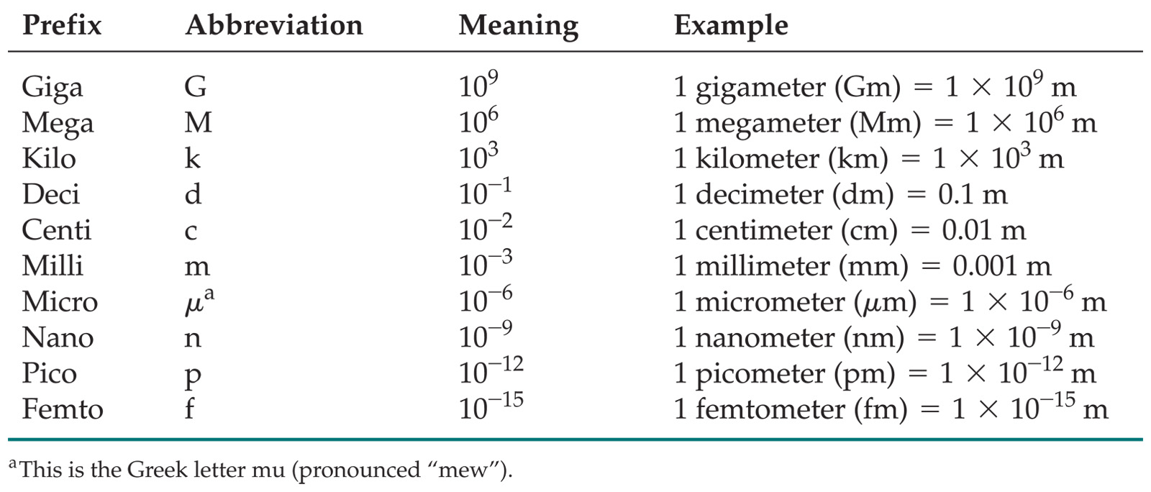
Metric System
Prefixes convert the base units into units that are appropriate for the item being measured.
Learn! More important than it looks!!!

Slide 6
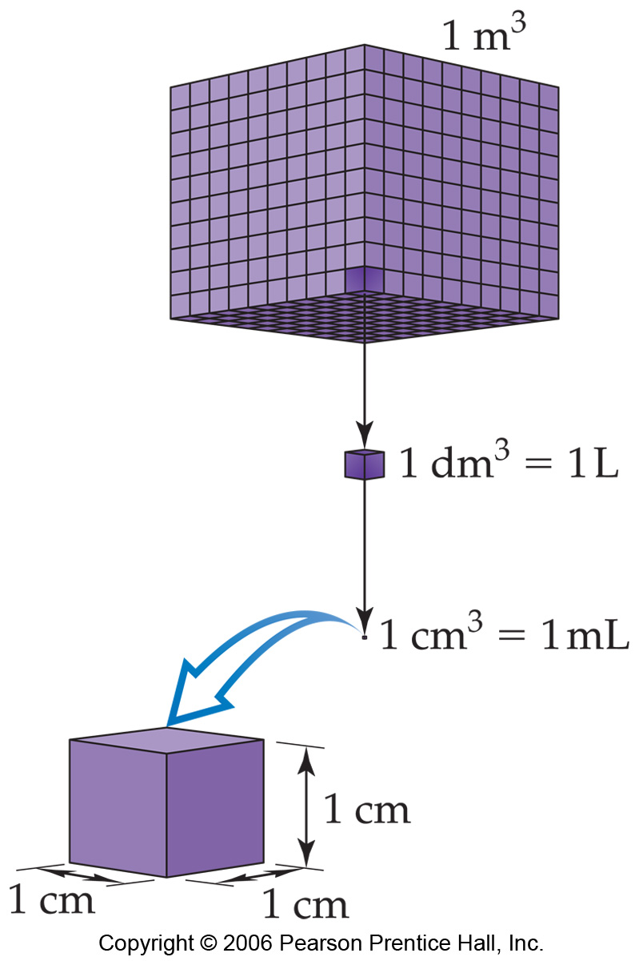
Volume
The most commonly used metric units for volume are the liter (L) and the milliliter (mL).
A liter is a cube 1 dm (10 cm) long on each side.
A milliliter is a cube 1 cm long on each side.

Slide 7
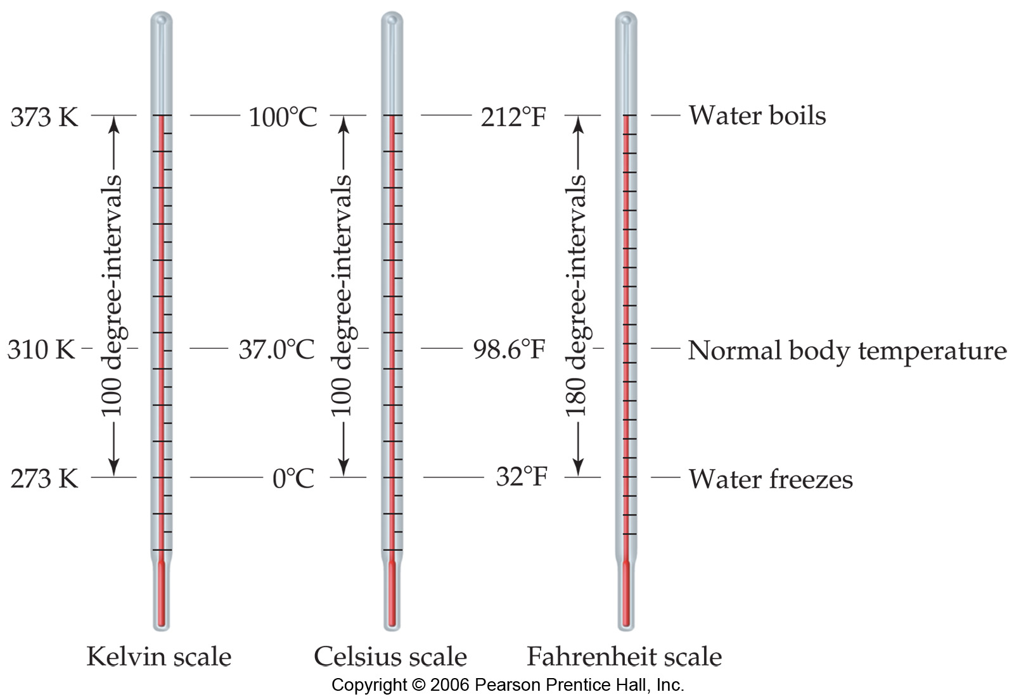
Temperature:
proportional to the average kinetic energy of the particles in a sample.
K.E. = 1/2mv²

Slide 8
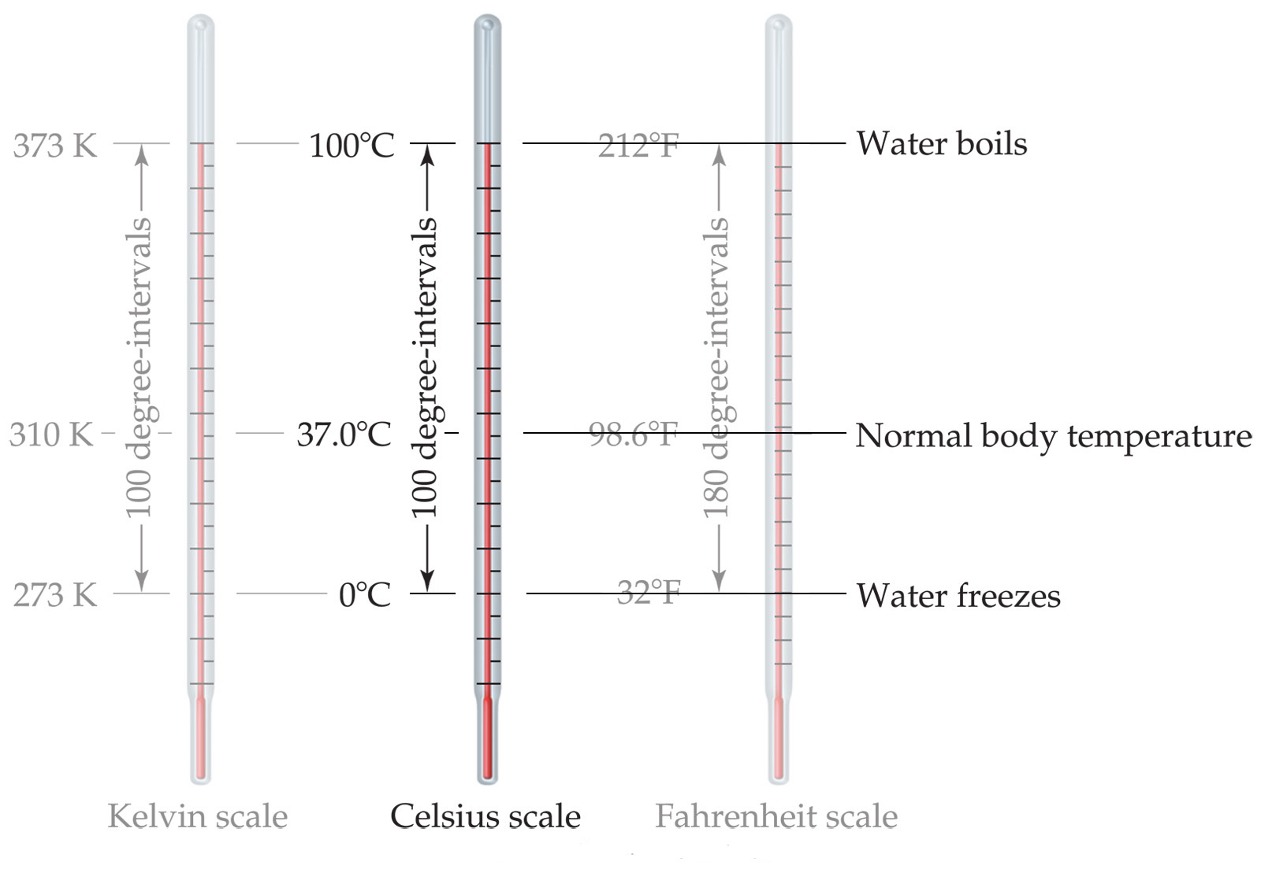
Temperature
In scientific measurements, the Celsius and Kelvin scales are most often used.
The Celsius scale is based on the properties of water.
0°C is the freezing point of water.
100°C is the boiling point of water.

Slide 9
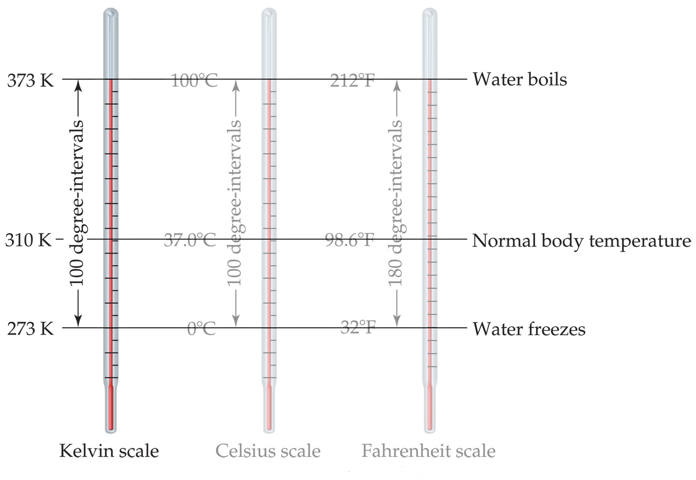
Temperature
The Kelvin is the SI unit of temperature.
It is based on the properties of gases.
0 K = 0 K.E.
There are no negative Kelvin temperatures.
K = °C + 273.15

Slide 10
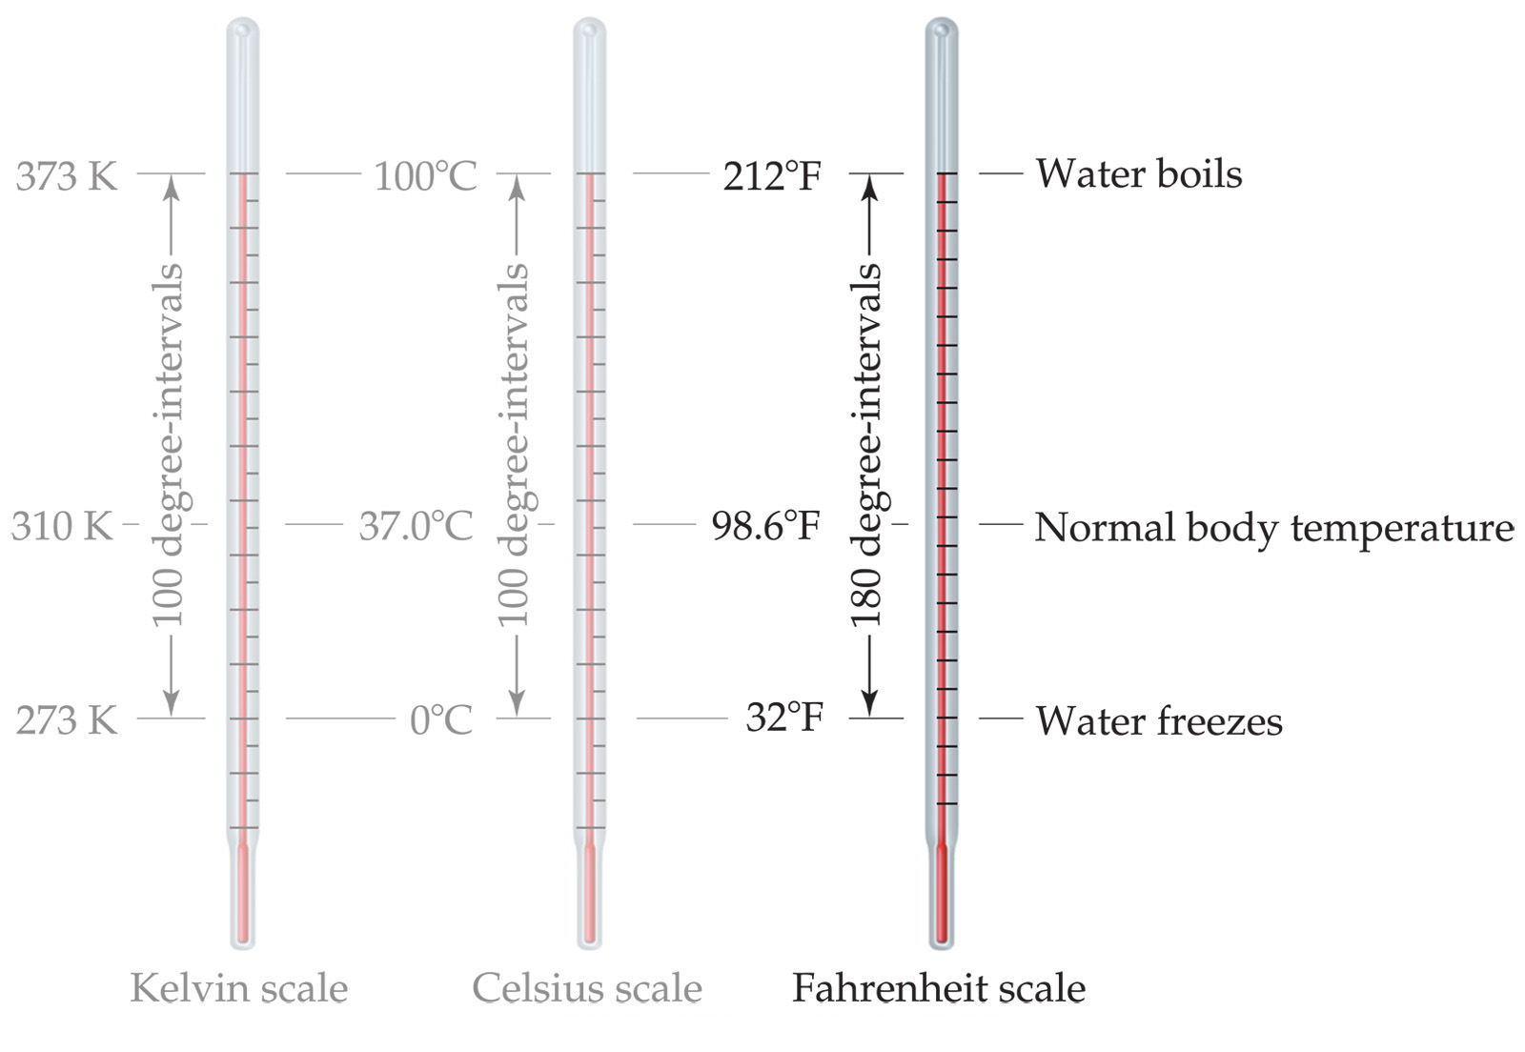
Temperature
The Fahrenheit scale is not used in scientific measurements.
°F = 9/5(°C) + 32
°C = 5/9(°F) − 32

Slide 11
Density:
Is a physical property of a substance
Intensive.
m
V
d=

Slide 12
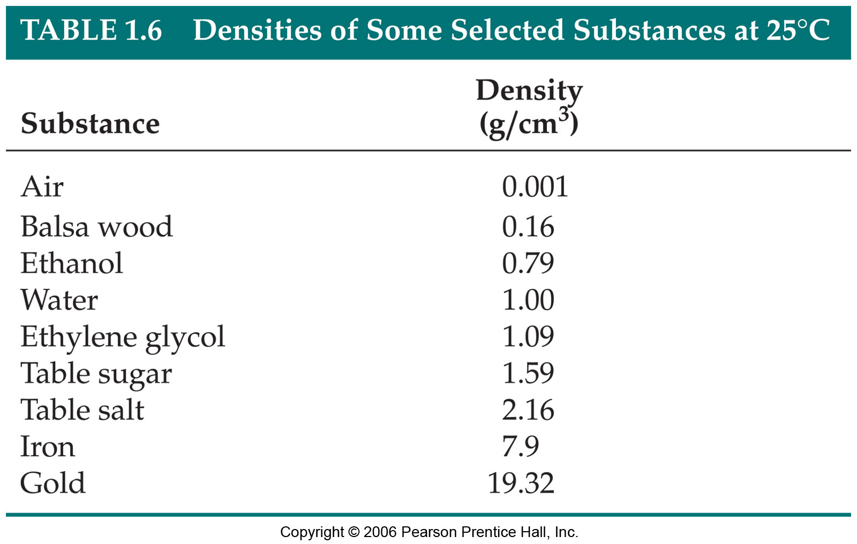
Density of selected substances

Slide 13
SAMPLE EXERCISE 1.4: Determining Density and Using Density to Determine Volume or Mass
Calculate the density of mercury if 1.00 × 10² g occupies a volume of 7.36 cm³.
Calculate the volume of 65.0 g of liquid methanol (wood alcohol) if its density is 0.791 g/mL.
What is the mass in grams of a cube of gold (d = 19.32 g/cm³) if the length of the cube is 2.00 cm?
(a)
G: m = 1.00 × 10² g
v = 7.36 cm³
R: density, d
S:

Slide 14
SAMPLE EXERCISE 1.4: Determining Density and Using Density to Determine Volume or Mass
Calculate the volume of 65.0 g of liquid methanol (wood alcohol) if its density is 0.791 g/mL.
What is the mass in grams of a cube of gold (d = 19.32 g/cm³) if the length of the cube is 2.00 cm?
(b)
G: d = 0.791 g/mL
m = 65.0 g
R: volume, v
S:

Slide 15
SAMPLE EXERCISE 1.4: Determining Density and Using Density to Determine Volume or Mass
What is the mass in grams of a cube of gold (d = 19.32 g/cm³) if the length of the cube is 2.00 cm?
R: mass, m
volume, v
G: d = 19.32 g/cm³
l = 2.00 cm
A: We can calculate the mass from the volume of the cube and its density; the volume of the cube is length cubed.
S:

Slide 16
Homework
Read pp. 14-30
Exercises #1.25 – 1.30
☺

